Slide 1


SPOTIFY MACHINE LEARNING PROJECT
HUANG ZHUOHANG
EKTA SHARMA
VIGHNESH SHETTTY
WANG YUZHE

Slide 2

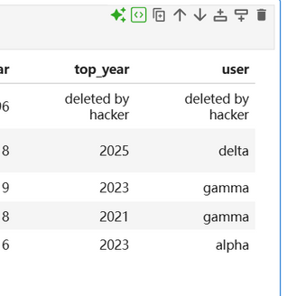
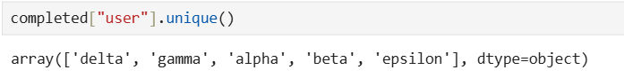
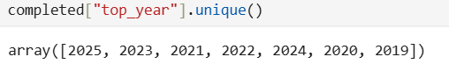
PROJECT OBJECTIVE
Build machine learning models using Spotify audio features
Predict user preferences / labels
Compare multiple classification algorithms

Slide 3
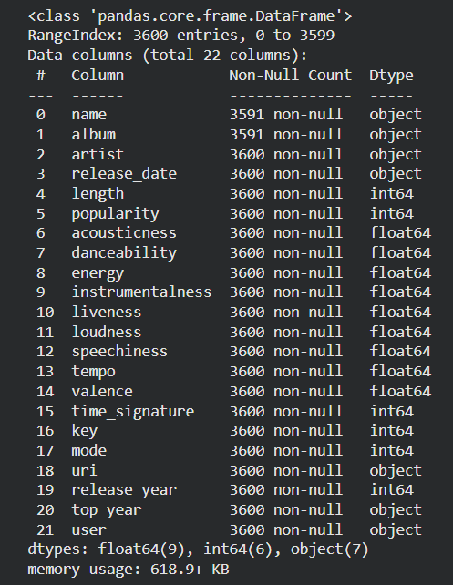
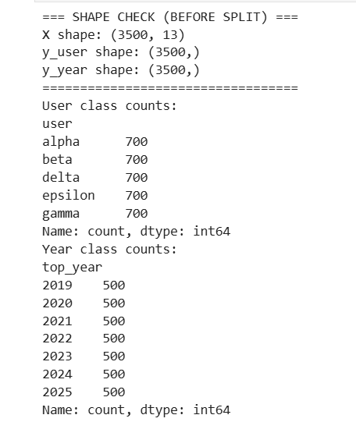

DATASET OVERVIEW
Spotify audio features dataset
Includes danceability, energy, loudness, tempo, valence, etc.
Data cleaned and filtered before modeling

Slide 4
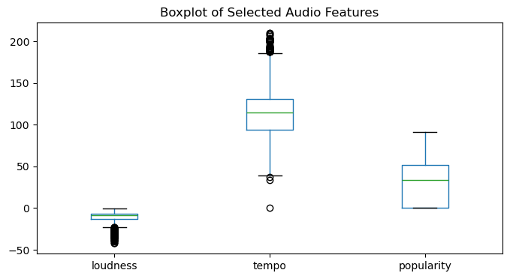
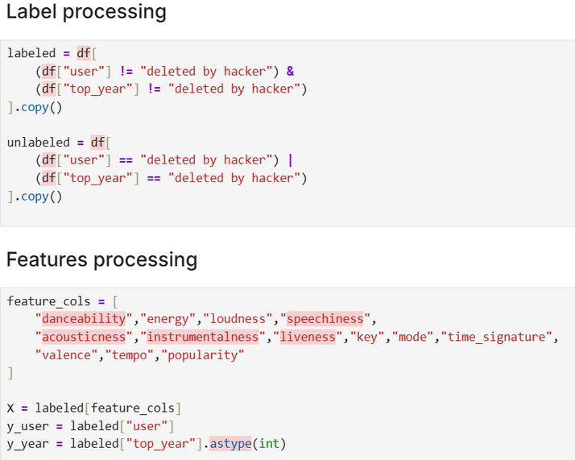
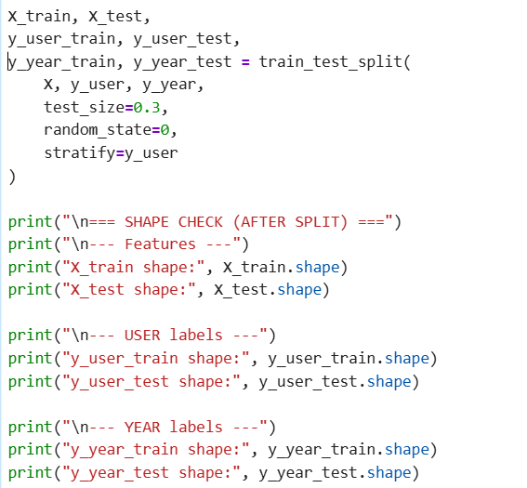
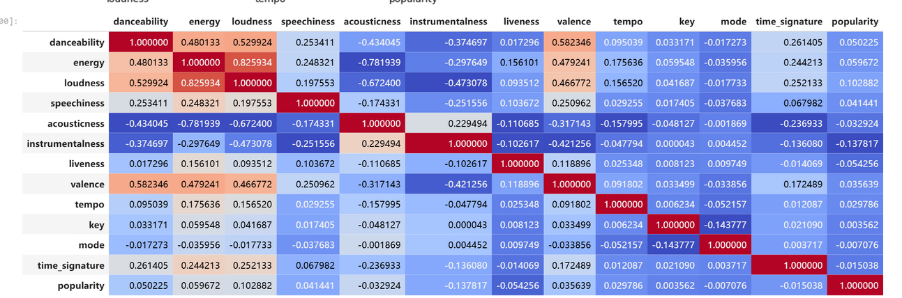
DATASET EXPLORATION
PROCESSING
SPLIT

Slide 5


MODELS IMPLEMENTED
Tasks 1 :
Song → User
Song → Year
Input: standardized audio features
Output: categorical labels
Why supervised learning?
Labels available for 3500 songs
Clear prediction targets
•Logistic Regression
•K-Nearest Neighbors (KNN)
•Support Vector Machine (SVM)
•Decision Tree

Slide 6
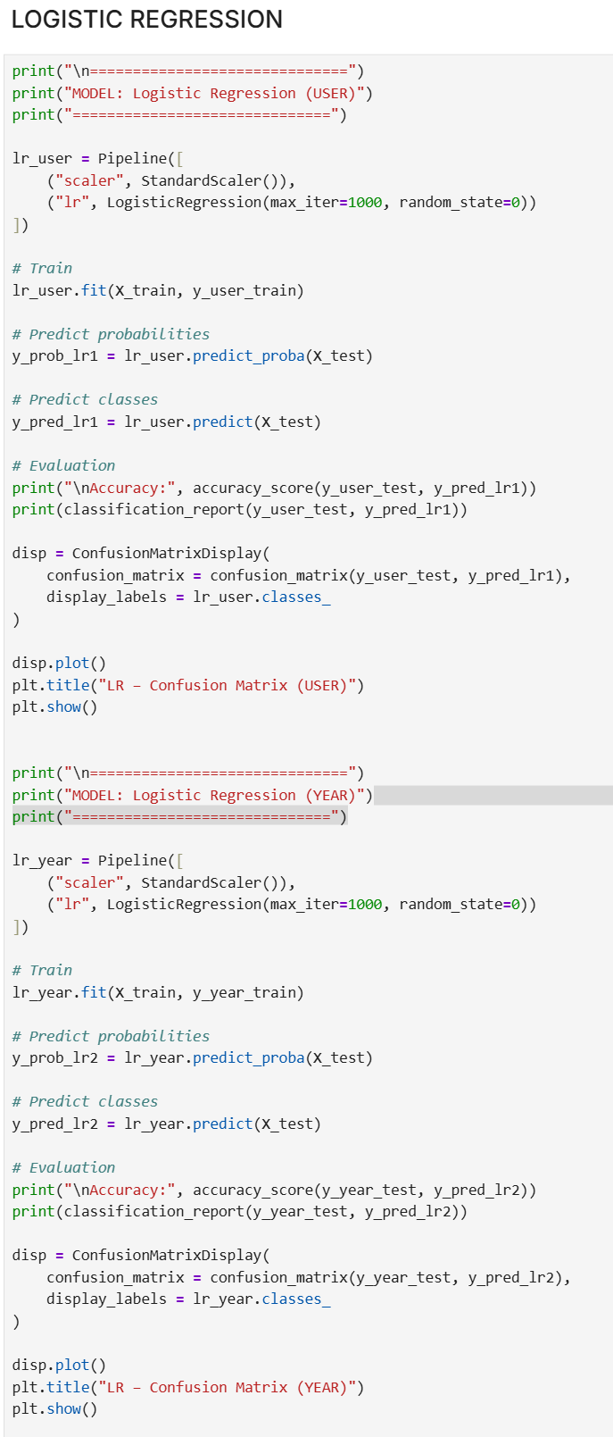
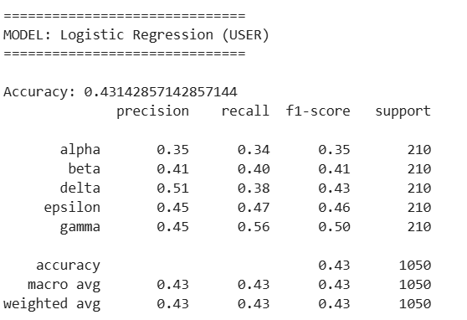
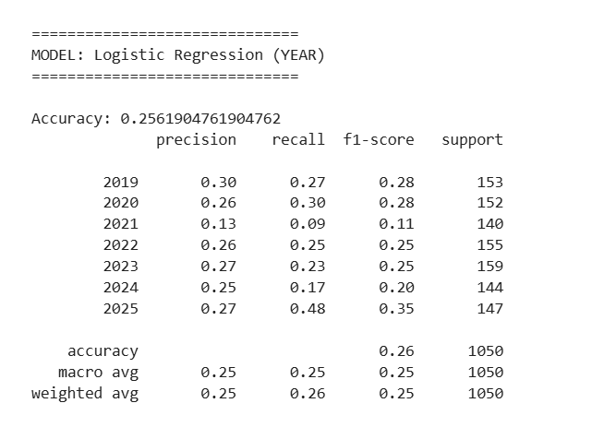

Slide 7
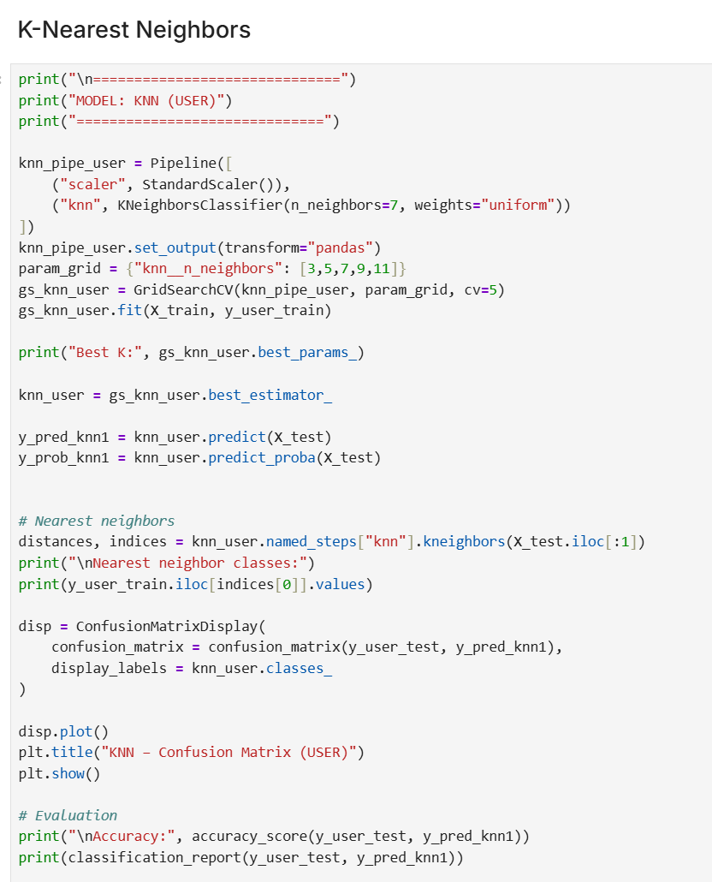
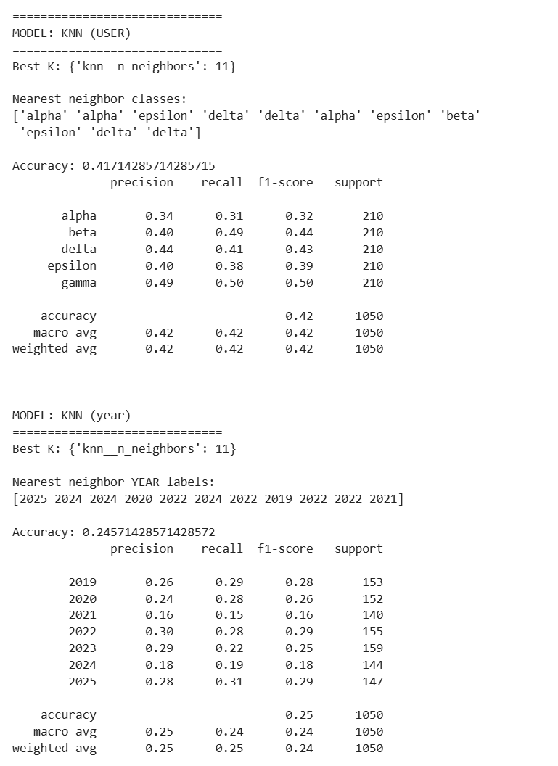

Slide 8
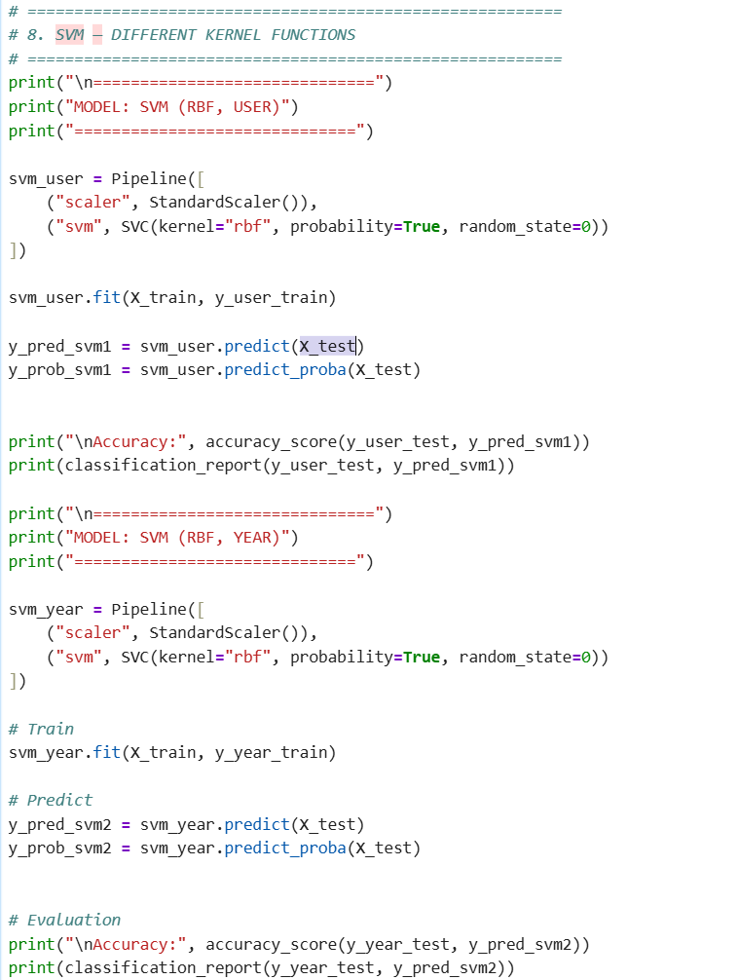
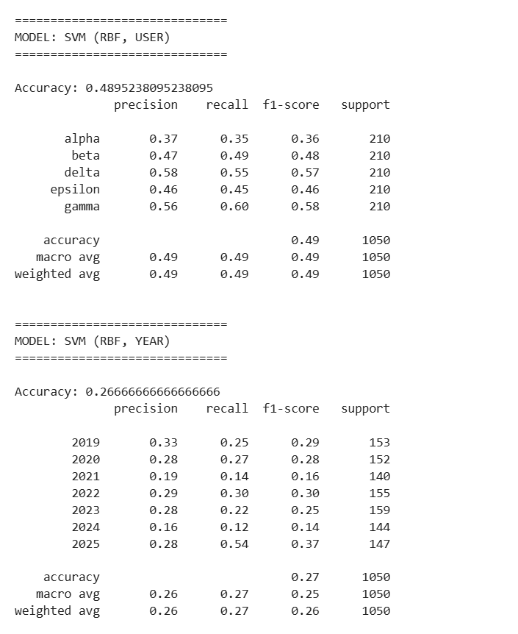

Slide 9
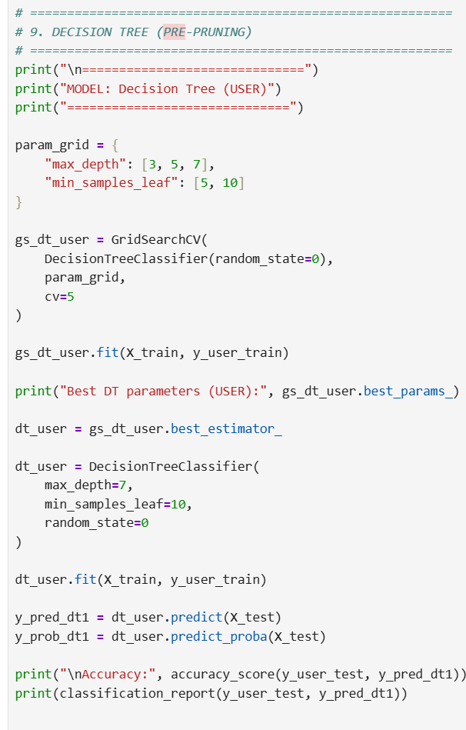
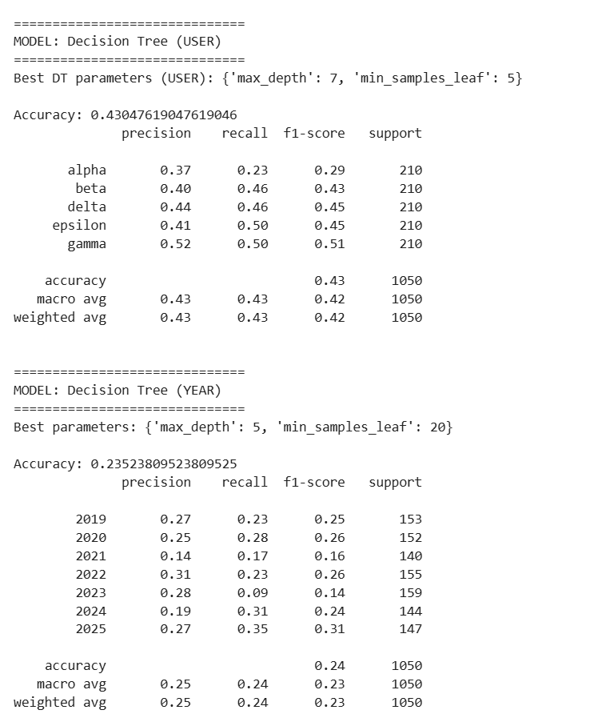

Slide 10


MODELS USED AND JUSTIFICATION
We used several models to classify songs based on audio features, each chosen for its strengths. Logistic Regression provided a simple, fast baseline and highlighted linear relationships. KNN classified songs by feature similarity, while SVM captured non-linear patterns in high-dimensional data. Decision Trees were easy to interpret

Slide 11


EVALUATION METRICS
Confusion matrix
Accuracy score
Classification report

Slide 12
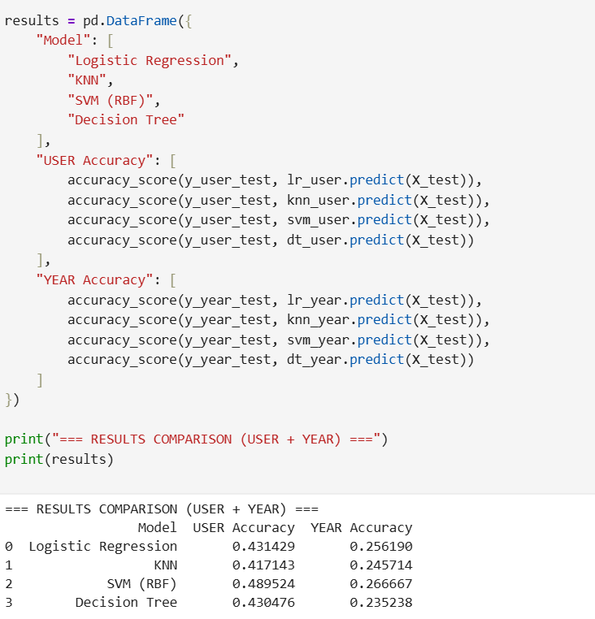
RESULTS SUMMARY
Multiple models compared
SVM and ensemble models performed strongest
Feature scaling significantly improved results

Slide 13
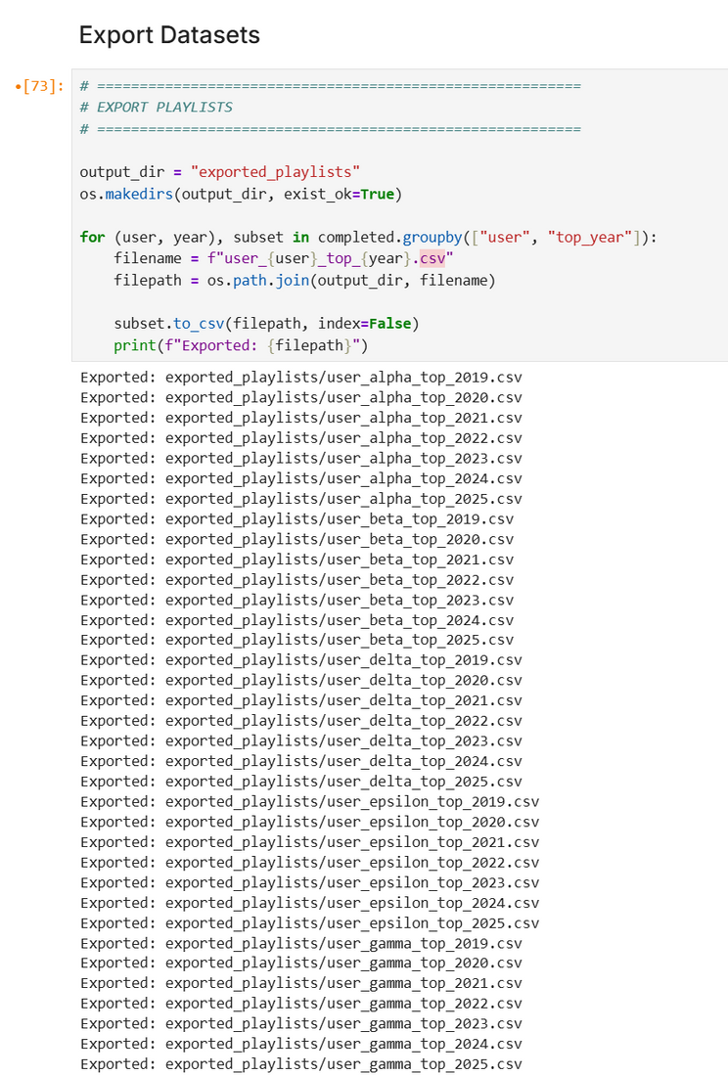
PREDICTION RESULTS
TAKES THE COMPLETED DATASET (AFTER PREDICTING MISSING USER AND YEAR LABELS),
Groups songs by user and top_year,
Exports each group as a separate playlist file.
This step translates model predictions into concrete, usable playlist outputs, which is the ultimate objective of Task 1.

Slide 14
Task 2 - Recommendation Algorithm Design for Spotify Family Accounts
Building a personalized song recommendation system that leverages both individual preferences and shared family listening patterns to deliver relevant music suggestions.

Slide 15


Slide 16


Slide 17
From Implicit Feedback to Supervised Learning Labels
Key idea
Recommendation data does not contain explicit labels.
To apply supervised learning, we transform listening history into labeled examples.
Implicit feedback must be converted into training labels.
Positive samples (y = 1)
Songs appearing in the user’s reconstructed playlists
Represent implicit “like” signals
Negative samples (y = 0)
Songs not present in the user’s playlists
Randomly sampled from the candidate pool
Absence of interaction ≠ explicit dislike
But serves as a weak negative signal
Standard approach in implicit-feedback recommendation systems
This formulation enables classical supervised classifiers to be trained on recommendation data.

Slide 18
Handling Cold-Start and Sparse User Histories
Cold-start user
Very limited listening history
Personal taste model is unreliable
Data sparsity in family accounts
Some users listen much less than others
Pure personalization may overfit
Hybrid Recommendation as a Solution
Hybrid scoring function:
Content-based: individual musical taste
Collaborative: shared family listening patterns
α controls the balance between the two

Slide 19

Home
Service
About Us
Contact
THANK YOU

